Slide 1
GSP IAC Meeting
Let’s do lunch!

Slide 2

Game & Simulation Programming (GSP) Program Industry Advisory Committee Meeting
Welcome!!!
21 January 2010

Slide 3
GSP IAC Meeting – 13 Jan 2011
Agenda
Introductions and Lunch
Who is DeVry University?
What is an Industry Advisory Committee?
What is the Game & Simulation Programming Program?
Discussions

Slide 4
GSP IAC Meeting
Who is DeVry University?
WE ARE NOT . . .
A Vocational Training School
A Technical Training School
An Art School

Slide 5
GSP IAC Meeting
Who is DeVry University?
WE ARE. . .
Fully Accredited
A Six Year University with Associate, Bachelor’s, and Master’s Degree Programs
Recognized provider of quality graduates
80 years of quality education

Slide 6
GSP IAC Meeting
Who is DeVry University?
Five Colleges:
Business & Management
Engineering & Information Sciences
Liberal Arts & Sciences
Media Arts & Technology
Health Sciences

Slide 7
GSP IAC Meeting
Who is DeVry University?
Other Fun Facts:
More than 90 locations across the US and Canada -- plus online courses.
Student Career Success Rate of Over 90% overall --but not the GSP Program

Slide 8
Employment Statistics for GSP
GSP Specific Career Success
59% for all DeVry.
Fremont has been consistently higher, but we still have work to do.

Slide 9
GSP Employment – Gaming Industry
Namco Networks of America
Jr. PC Game Engineer
Namco Bandai of America
Quality Assurance Tester
Kalloc Studios
Intern Programmer
EA Jobs
CQC Tester
PSINAPSE
Game Tester
Wireless Mobi Solution
Game Applications Test Engineer

Slide 10
GSP Employment – Gaming Industry
Leapfrog
Quality Assurance Test Engineer
Electronic Arts
QA Programmer
Wireless Mobile Solution
Game Applications Test Engineer
Aerotek
Software Quality Assurance Tester
Sony
Game Tester
Namco Networks of America
Jr. PC Game Engineer Intern

Slide 11
Employment: Non-Gaming
Hewlett Packard
Software Programmer
Barracuda Networks
Software Engineer
NASA
Post Graduate Intern
Peking
Jr. IT Professional
Lifescan, Inc
Application Quality Specialist II
Docustream
Database Administrator
Translations.com
Localization Analysis Engineer

Slide 12
GSP IAC Meeting
What is an Industry Advisory Committee?
Once a year, DeVry hosts a meeting with industry professionals at every Campus for each program
The goal is to get feedback on the program curriculum.
The question we are trying to answer is: Does our new curriculum meet industry needs.

Slide 13
GSP IAC Meeting
What is the Game & Simulation Programming program?
Bachelor of Science Degree
8 semesters
Software engineering with a focus on the game and simulation industry
Prepares student for entry job in the game or simulation industry

Slide 14
GSP IAC Meeting
What is the Game & Simulation Programming program?
60% Liberal Arts & Science
40% Core Courses
One elective in Core Courses
Higher math requirements than our Computer Information Systems program
Must be fully qualified for entry into the program

Slide 15
GSP IAC Meeting
What is the Game & Simulation Programming program?
Key Skills and Knowledge
Software Engineering
Teamwork
Project Management
Game Industry Processes
Communications
Written
Verbal

Slide 16
GSP IAC Meeting
What is the Game & Simulation Programming program?
Faculty
Six Adjuncts
Two Fulltime
Both have game industry background
4 have extensive game industry background
Programming (3)
Producer and Content (1)
One has extensive academic AI and programming background
One has a PhD and is a recent GSP graduate

Slide 17
GSP IAC Meeting
What is the Game & Simulation Programming program?
Focus on C++ Programming
Programming every semester
Programming almost every session
Four project courses
One course on the industry
One design course

Slide 18
GSP IAC Meeting
Program Course Areas | Number of Courses | Total Credit Hours
Communication Skills | 4 | 15
Humanities and Social Sciences | 6 | 18
Personal & Professional Development | 2 | 5
Math and Science | 5 (2) | 19 (8)
Game & Simulation Core | 7 (1) | 28 (4)
Programming | 3 | 12
Advanced Programming | 5 | 20
Technical Alternate | 1 | 4
Projects | 4 | 8
Total | 37 | 129

Slide 19
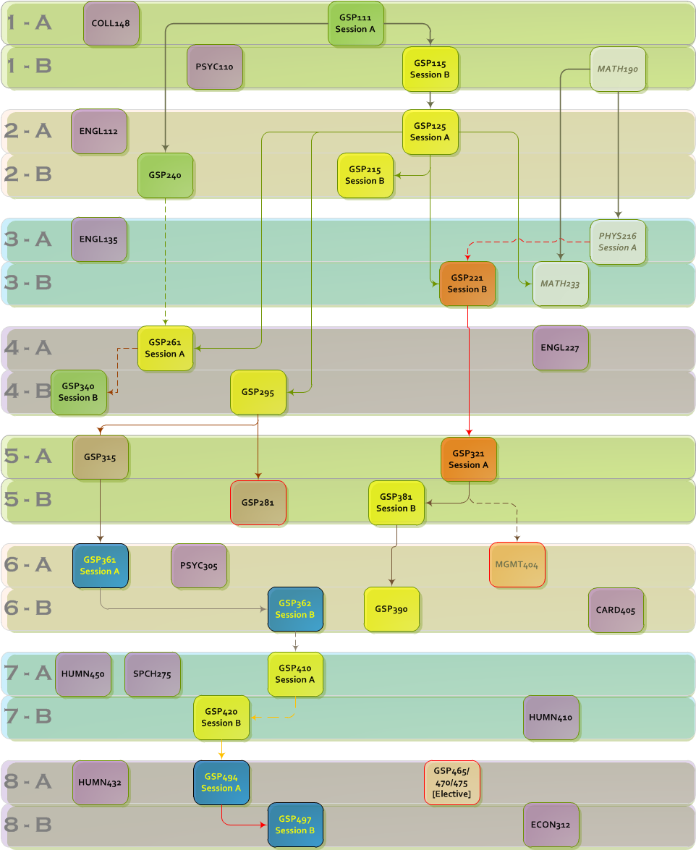
GSP IAC Meeting

Slide 20
GSP IAC Meeting
Discussion
Feedback
Curriculum strengths
Curriculum weaknesses
Program goals
Industry Awareness
How can we improve it?

